Slide 1
A story about returning to school

Slide 2
I go to St. Luke's CE School.

Slide 3
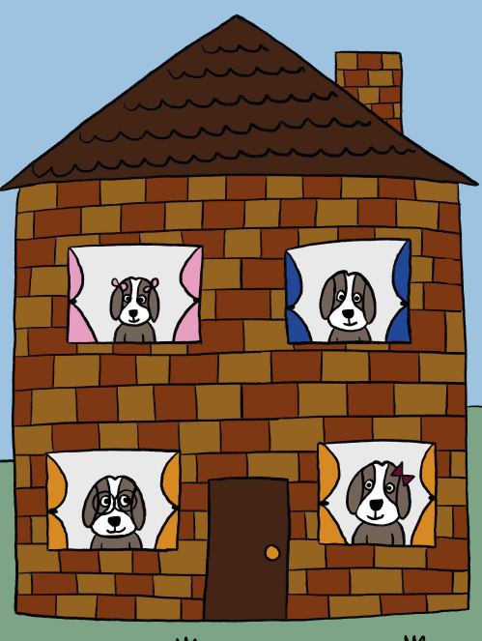
We started the school year in a classroom.
Because of covid-19 we have spent some time at home, to try and stop the spread of the virus.
We tried to do our school work at home and did different activities.

Slide 4
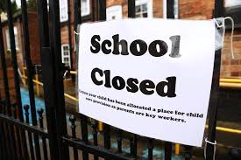
The government have recommended that all children can come back to school.

Slide 5
Some things in school will be different.

Slide 6
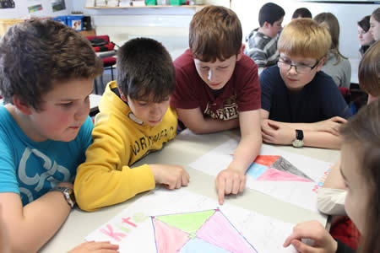
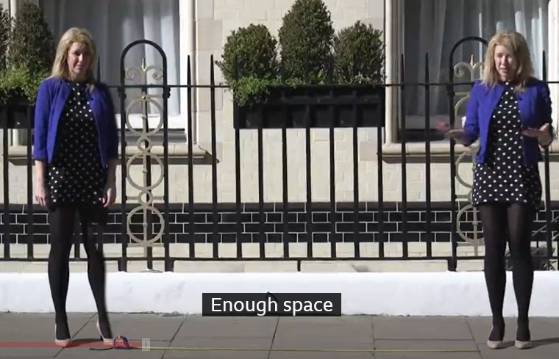
We need to try and practice ‘social distancing’ which means we should try to stay around 2 metres away from anyone else, apart from the people we live with.

Slide 7
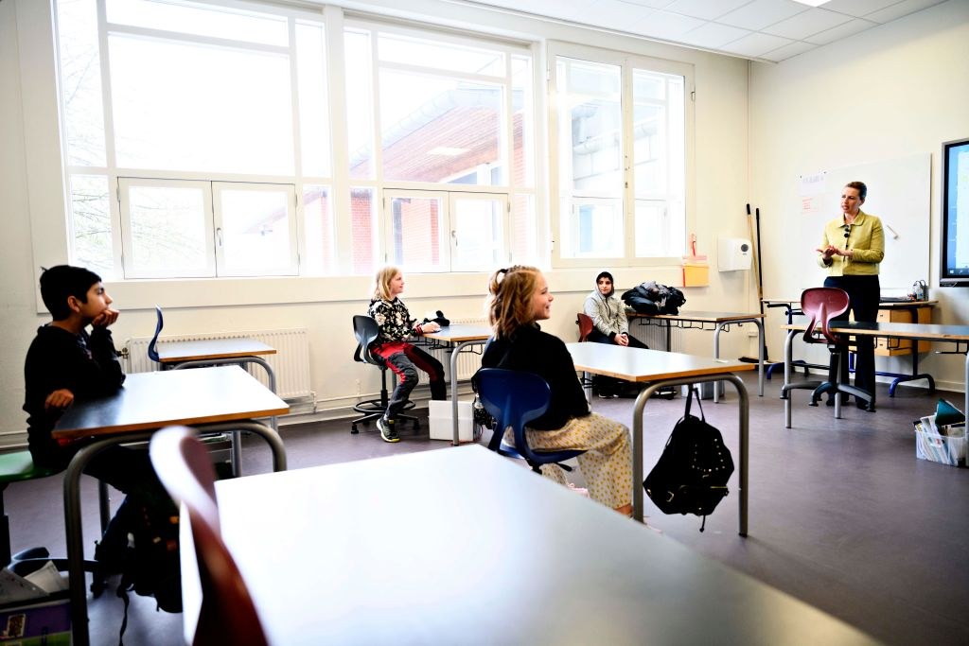
Our desks may look different, they might be in rows or in tables of two.

Slide 8
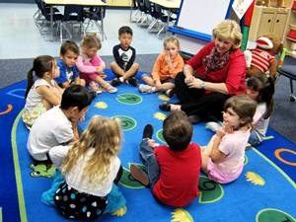
Your year group is your ‘bubble’ – this means you may get closer than 2 metres from them.
You will also have playtime with only your year group, it is best to maintain social distancing.

Slide 9
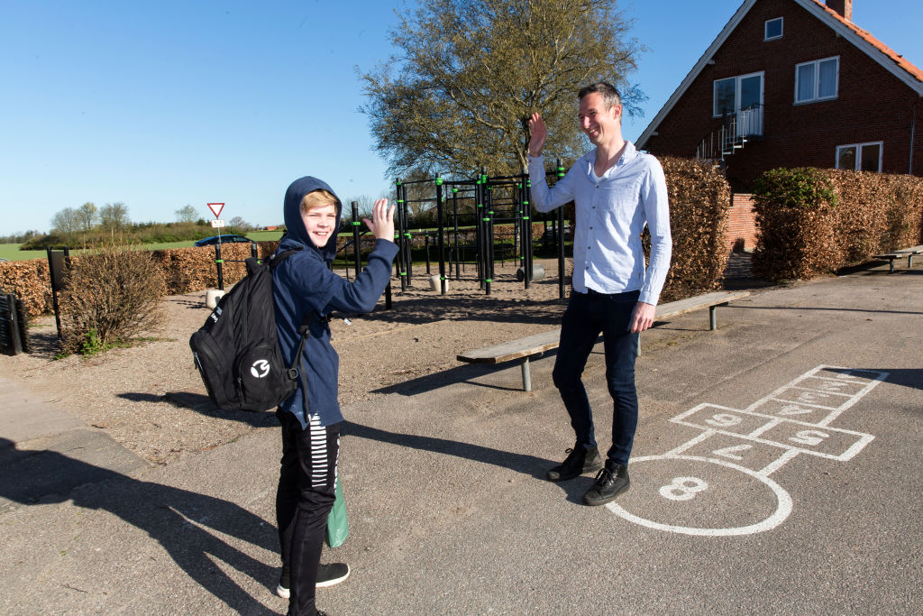
You may be excited to see your teachers or friends. You can greet them by waving, saying their name, and asking them how they are.

Slide 10
Your class may have new routines when you arrive.
You may have to use hand sanitiser as well as washing your hands.

Slide 11
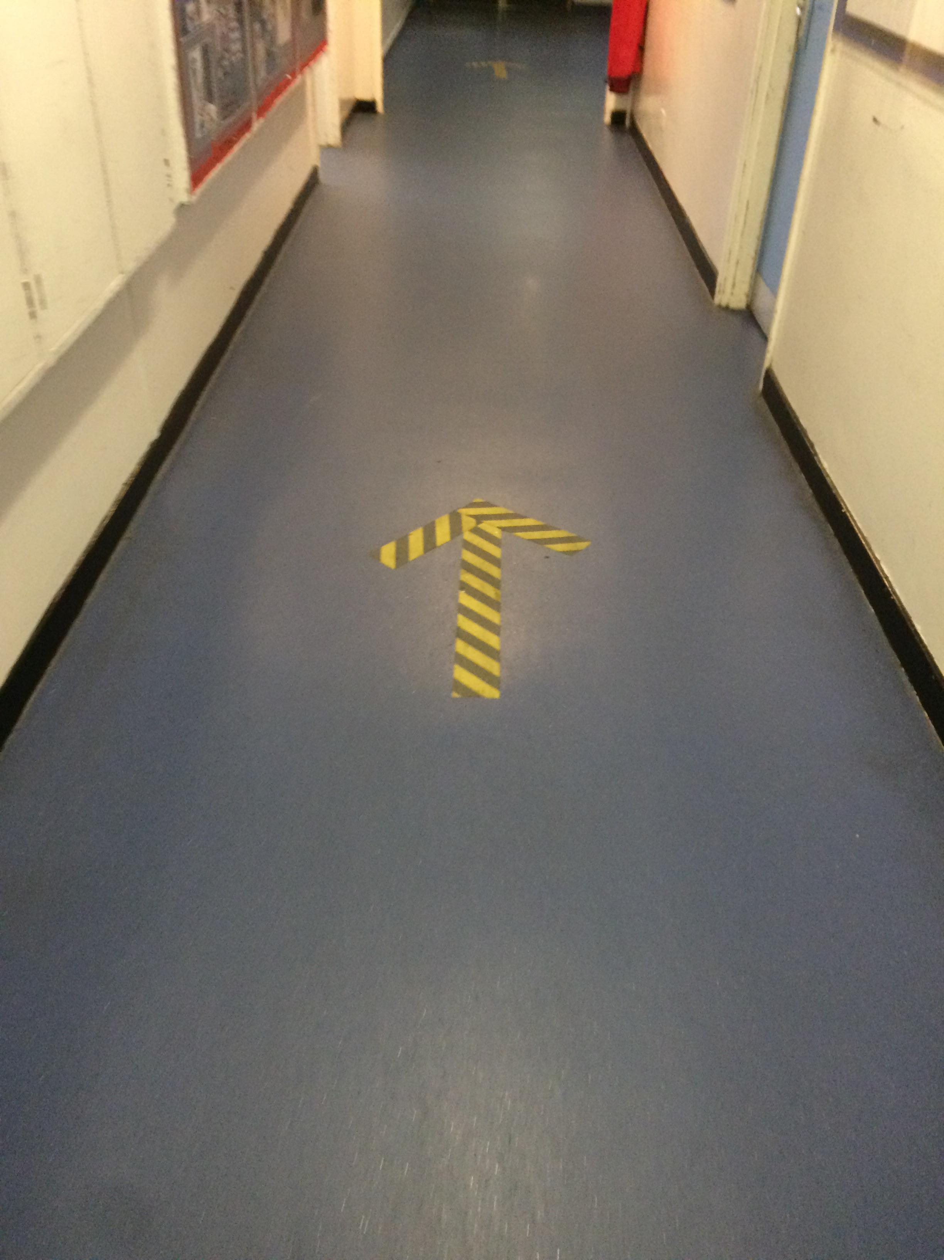
There is a ‘one way’ system in corridors so you don’t pass anyone else.

Slide 12
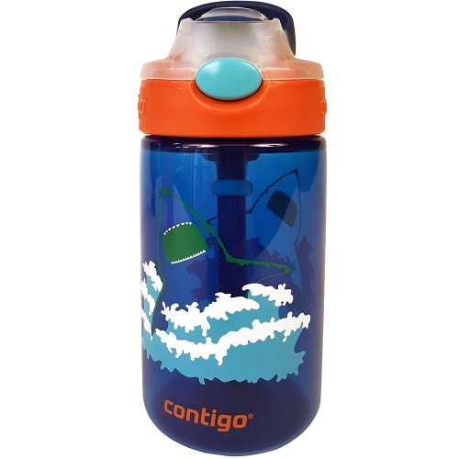
We must try not to touch other people or their things, so this means we have our own things on our desks and you can bring our own water bottle.
We cannot share these things at the moment.

Slide 13
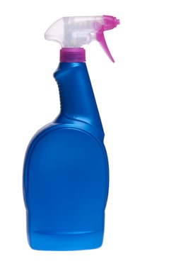
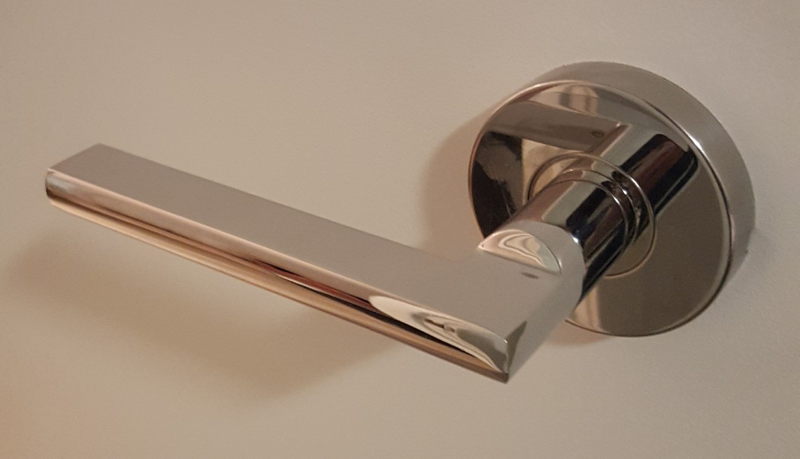
Lots of things will be washed and disinfected during the day and when you go home.
Things like door handles will be cleaned – this helps keep us safe.

Slide 14
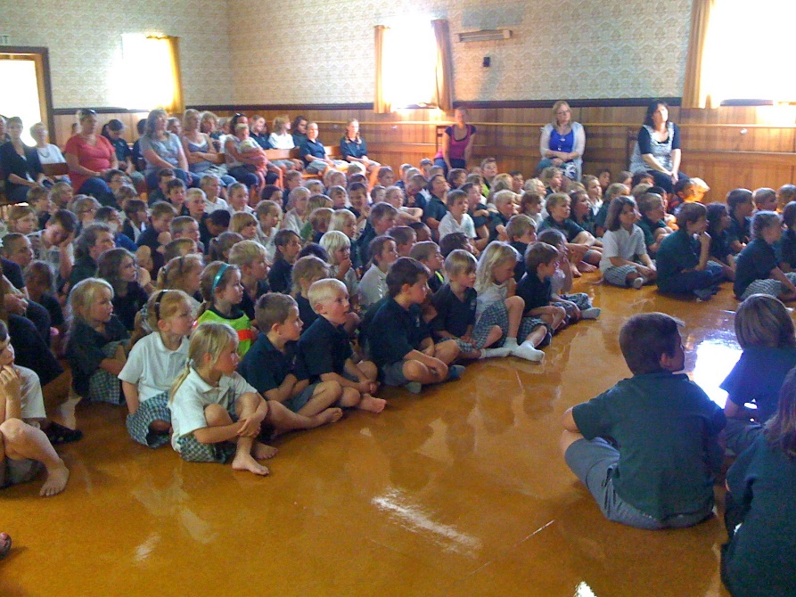
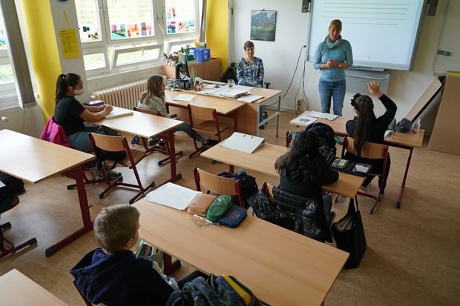
As gatherings are not allowed at the moment, we won’t have assembly as a big group in the hall but may meet as small group or via video link instead.

Slide 15
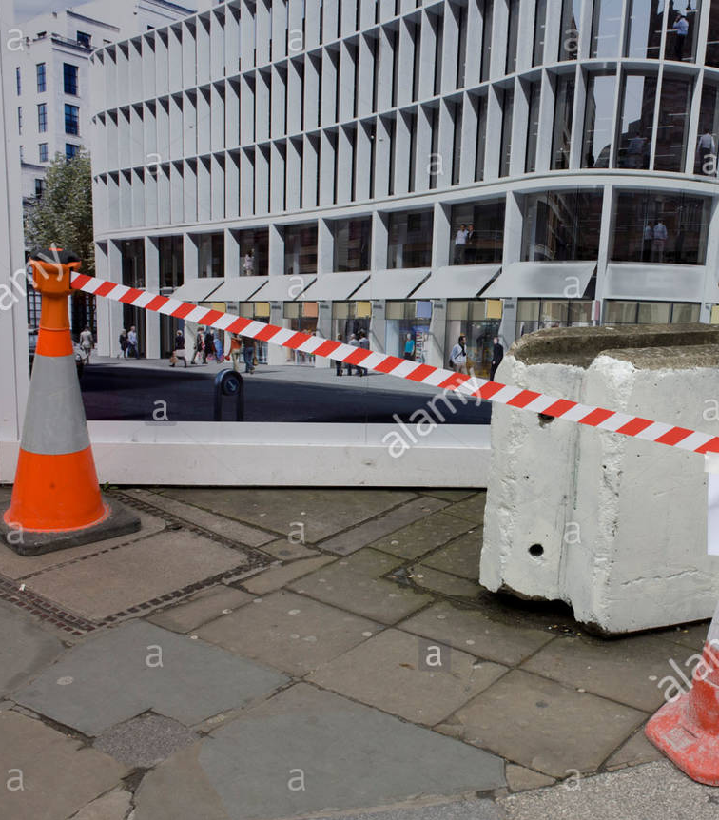
There may be some parts of the school where you are not allowed. These will be marked by tape on the floor or doors.

Slide 16
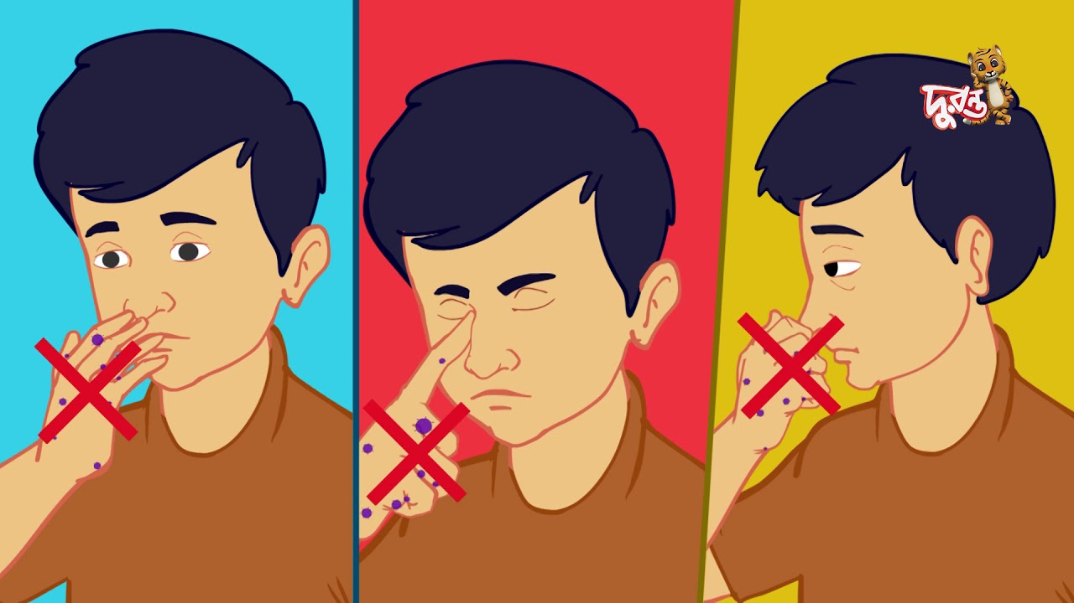
You should use tissues when you sneeze or cough and throw it straight in the bin.
Try not to touch your mouth, nose and eyes with your hands

Slide 17
The best way to stay safe is to regularly wash your hands. This should be for at least 20 seconds.

Slide 18
You can sing the ‘happy birthday’ song in your head twice to know you have washed them for long enough.

Slide 19
You may have a rota for when you can use the toilet so that all the children in the school can be kept safe.

Slide 20
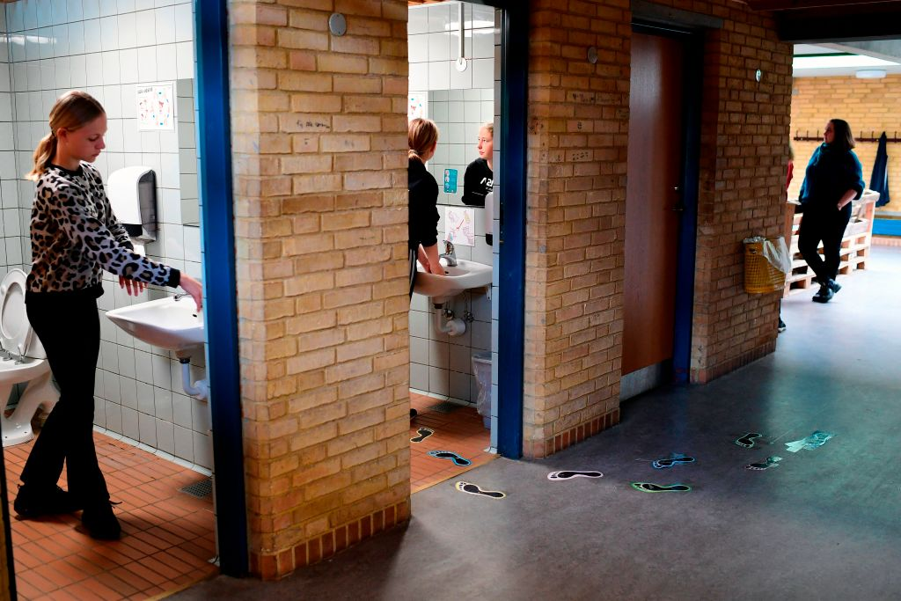
If someone is already in there, you may have to wait to use the toilet so that we can all keep a safe distance from each other.

Slide 21
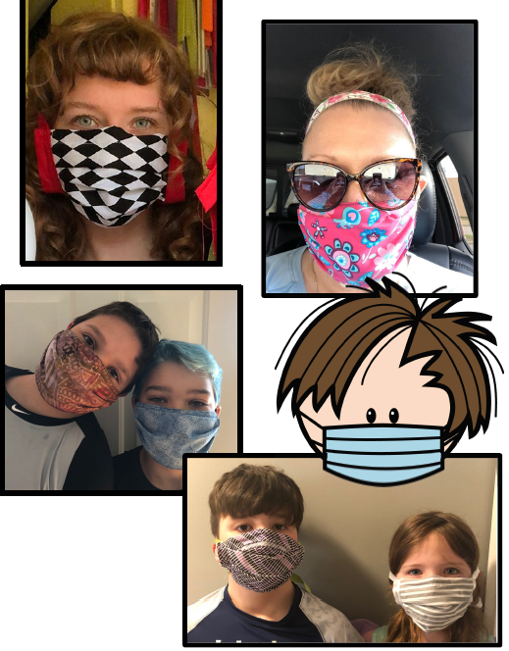
Some people may wear masks so that they don’t spread any bugs.
This may look different but its OK.

Slide 22
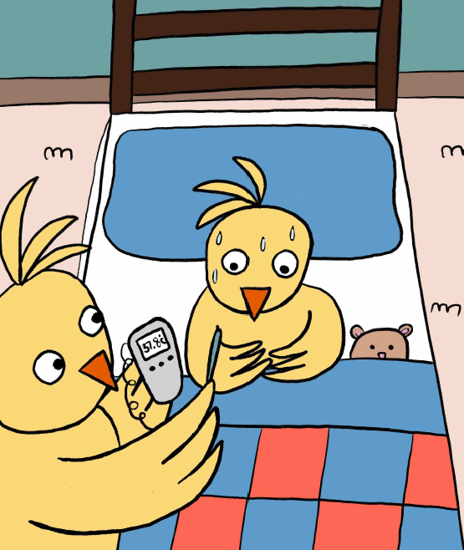
If you are feeling unwell, it is important to tell your teacher or parent as you may need to stay at home until you are better.

Slide 23
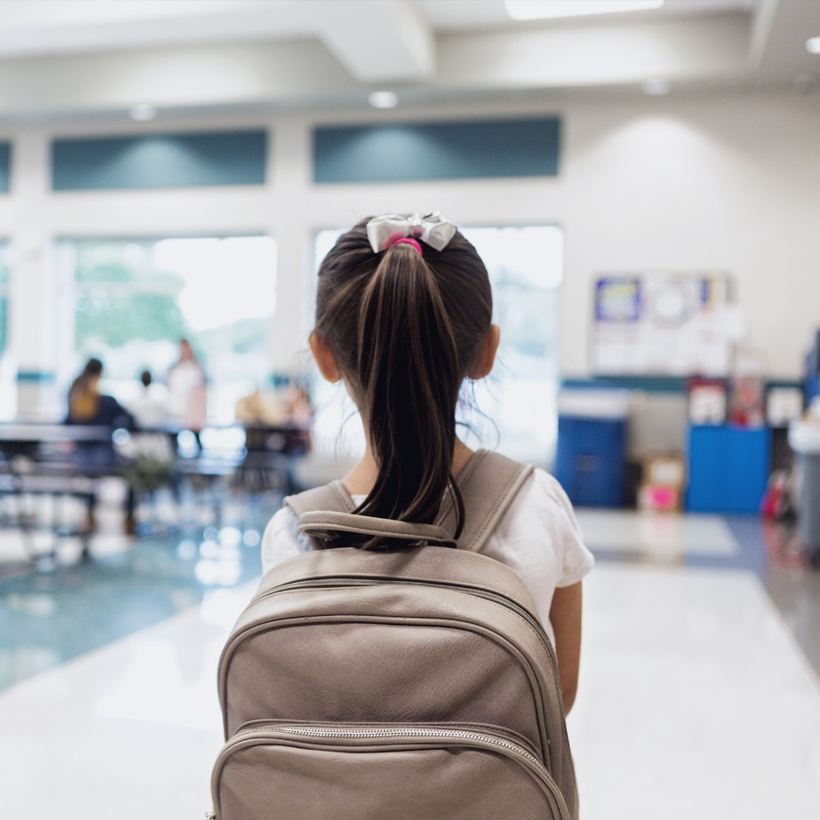
At the end of the day, you may be picked up from a different place.
You may have to wait – don’t worry, they are going to collect you.

Slide 24
Lots of things will be the same in school:
You will see some of the same teachers
You will see some of your classmates
Your building will be in the same place
Your school uniform will be the same
Most of the school rules will stay the same

Slide 25
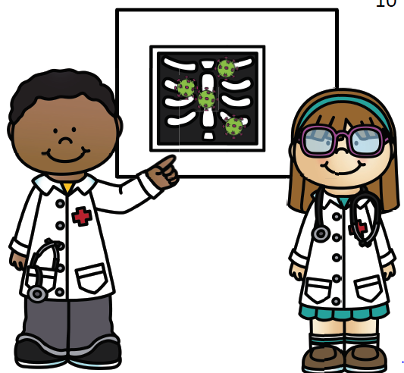
Doctors and researchers are working hard to find ways to make Covid-19 go away.
Once it is gone, we may be able to be closer to people at school again.

Slide 26
We don’t know how long this will take.
So for now we must keep each other safe by keeping socially distant as much as possible.

Slide 27
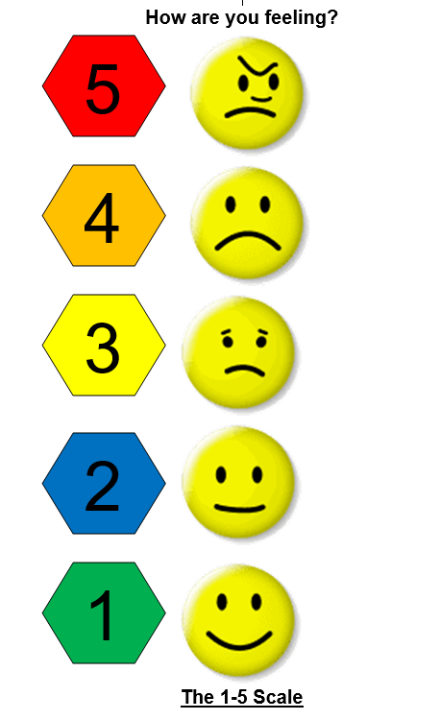
Lots of people are feeling worried at the moment.
You can always talk to your teacher or an adult in school about how you are feeling.

Slide 28
It is safe to be in school, and all the adults are so pleased to see you!

